Slide 1
Springboard - Capstone 2
Sidharth Ramanan

Slide 2
Project and Premise
Clustering Challenge from data.world
Data Scientist for non-profit organization whose goal is to increase university graduation rates for underprivileged populations
Rich dataset of university information to be clustered into characteristically similar groups to help advise non-profit with programs and strategies to achieve their mission

Slide 3
Dataset summary
7800+ observations
1700+ columns
Information such as debt, loan repayment rates, graduation rates, and various other conceivably relevant information pertaining to a university
Lots of missing data

Slide 4
Data Wrangling – Dimensionality reduction
Dataset has over 1700 columns – must be reduced
Several different strategies used:
Eliminating columns with all missing data
Eliminating columns with mostly missing data
Eliminating columns with constant data
Eliminating columns with mostly missing data
Eliminating highly correlated columns
Result: Dataset brought down to only 222 columns

Slide 5
Data Wrangling – Column Data Types
Some columns with numeric information encoded in Pandas as ‘object’ type
Reason was the presence of token “Privacy Suppressed” in some columns for observations that couldn’t collect information for that column due to privacy reasons
Replaced with np.nan and converted to numeric Pandas datatype
Any missing data imputed with median

Slide 6
Exploratory Data Analysis - Goals
One Goal was to try to manually find clusters by plotting regression variables and hue-ing with discrete categorizing feature
Another goal was to visualize data for interesting relationships, distributions, or outliers

Slide 7
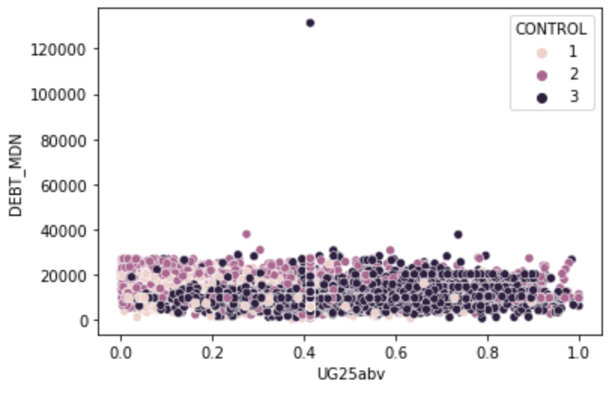
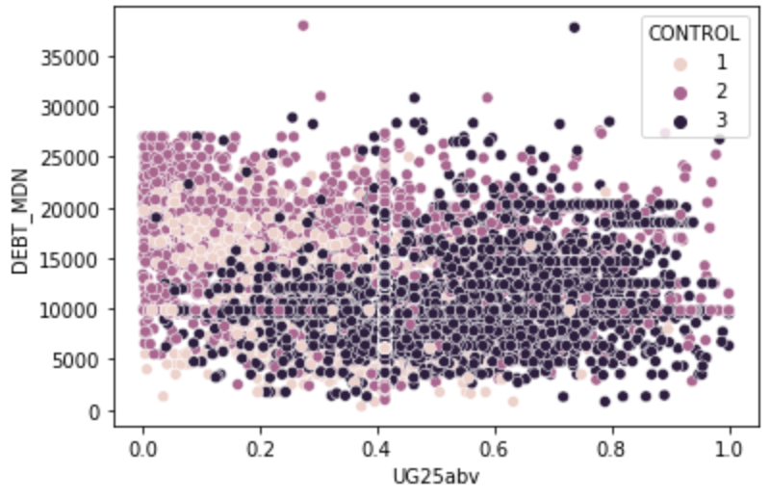
Exploratory Data Analysis – Outlier
Noticed outlier when plotting regression variables, removed after. Helper reinforce idea of paying attention to outliers in dataset
Before removing outlier
After removing outlier

Slide 8
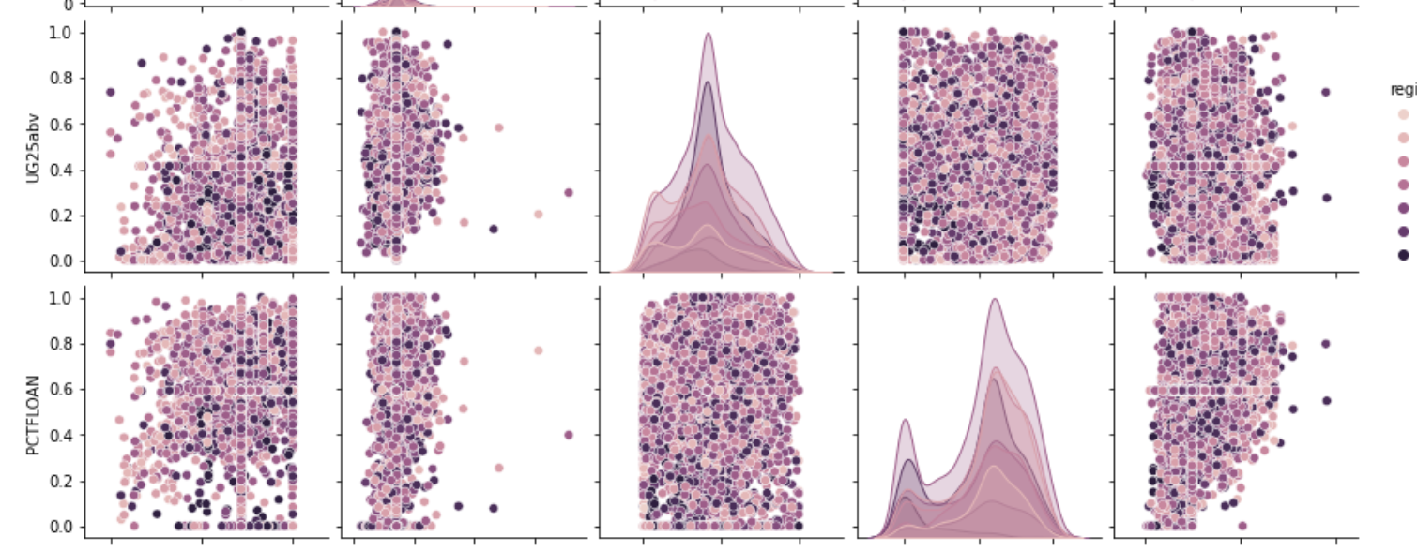
Exploratory Data Analysis - Pairplot
To investigate clustering relationships, decided to pairplot regression variable pairs with hue-ing variable
Noticed that PCTFLOAN has bimodal distribution, suggesting dataset has 2 natural groupings

Slide 9
Exploratory Data Analysis - Outcomes
Some outliers removed
Bimodal distribution detected on PCTFLOAN
Unfortunately, not many obvious clustering relationships could be manually found

Slide 10
Preprocessing – Outlier removal
Eliminate outliers in anticipation of running outlier-sensitive clustering algorithms in modeling phase
Removing observations with features more than 3 standard deviations away from mean eliminated more than two-thirds of dataset
Playing with threshold value helped determine that 8 standard deviations best balanced data retention vs outlier removal

Slide 11
Preprocessing - Normalizing
Data needed to be normalized to uniform range for distance sensitive algorithms like K-Means
This is to give each feature an equal weighting during distance calculations
Data now ready for modeling

Slide 12
Modeling
3 types of clustering algorithms to be tested:
K-Means
Agglomerative Clustering
Gaussian Mixture Models

Slide 13
Modeling - Strategy
PCA to reduce data to 2 dimensions for cluster visualization and cluster interpretability
Manual hyperparameter grid searching to decide best hyperparameter combination for all models
Use inertia attribute to score K-Means models
Use Calinski-Harabasz score to evaluate best Agglomerative and GMM models

Slide 14
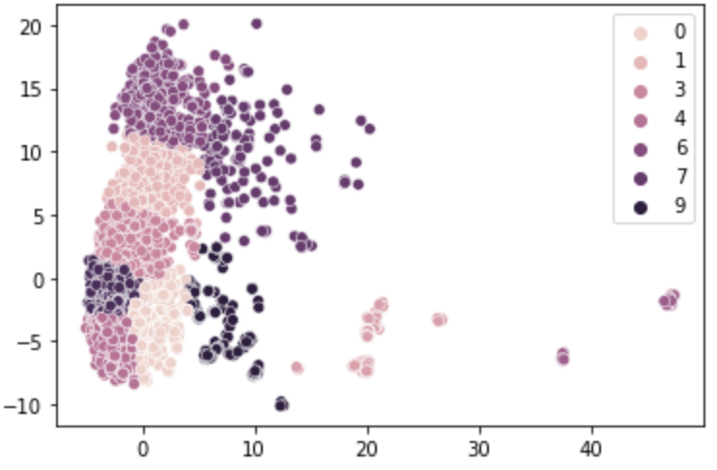
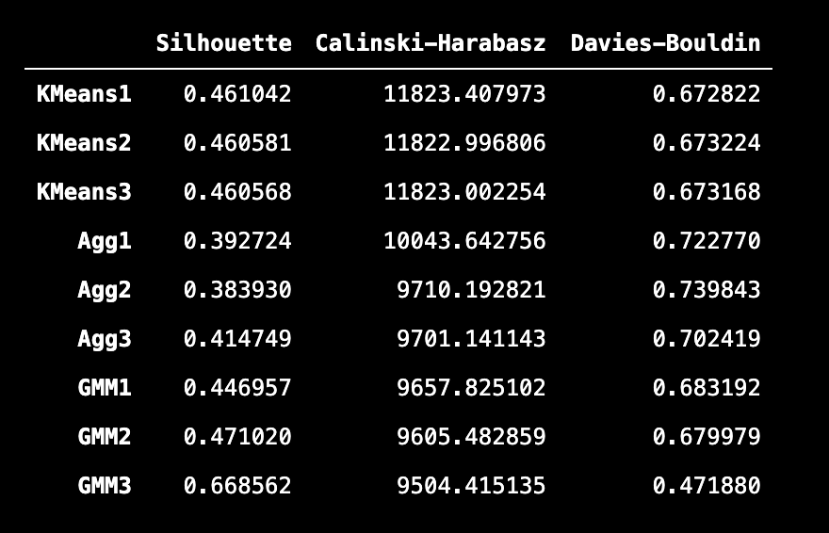
Modeling - Results
Top 3 models from each model type re-evaluated using Silhouette, Calinski-Harabasz and Davies-Bouldin clustering metrics
First K-Means model ranked the best
Best model had 10 clusters
Best Model Clustering on PCA embedded space

Slide 15
Modeling – Interpreting clusters
PCA components analyzed in terms of original features
Chose 3 columns from each PCA component with the highest absolute PCA co-efficients
Idea is that these columns characterize each PCA component the strongest and therefore help explain variance in dataset the best
Tradeoff in capturing variance versus including more columns in clustering analysis

Slide 16
Modeling – Aggregations on clusters
Using 6 most important features, aggregations based on cluster labels performed to produce mean, median, min and max for each column to produce new DataFrame
DataFrame analyzed in terms of column statistics to best characterize each of the 10 clusters

Slide 17
Some Clustering Inferences
One cluster that was very small generally had high levels of student debt
Another cluster was suffering from both extremely high levels of student debt and extremely low student loan repayment rates
A healthy cluster representing almost 40% of the data seemed to be well performing in terms of low debt and high loan repayment rates

Slide 18
Some recommendations
Non-profit should target the small cluster with large amounts of debt – manageable in size, easier to target. Can initiate some form of debt relief programs to help students pay off their debts
For cluster suffering with low debt but also low repayment rates, non-profit should potentially consider conducting career-building workshops for students who possibly are having trouble finding well-paying jobs after graduating and thus cannot pay even low debts

Slide 19
Conclusion - Learnings
Project helps underscore difference between being a ML engineer vs a Data Scientist
Real-world setting forces domain-specific and contextual thinking while analyzing data
High dimensionality of data is realistic expectation during real world data science and helps highlight importance of wrangling, visualization, and preprocessing before model fitting

Slide 20
Other avenues of research
Perhaps different dimensionality reduction can be performed, such as NMF
Preprocessing pipeline was very deep – definitely many parameters that can be tweaked to produce different model-ready datasets
Other clustering algorithms – maybe density-based clustering algorithms like DBSCAN?

